Slide 1



LUNG - AI
LUNG - AI
WWW.DERMAI.COM

Slide 2

CONTENT
DERM AI
01
ABOUT US
02
GOALS AND OBJECTIVES
03
ADVANTAGES
04
OUR SERVICES
05
IDEA AND APPROCH
06
HOW IT WORKS
07
NEXT UPDATE

Slide 3



ABOUT US
LUNG - AI
Our LUNG -AI is a AI based Lungs cancer Predection which helps in finding all of disease and provides First Aid and Remedies

Slide 4





GOALS AND OBJECTIVES
Objective n° 1
Objective n° 2
Our main objective is to collect all dataset regarding to all types of disease and classify them and label them for prediction.
The final Goal and objective is to develop an application for prediction of diseases and deploy it in the market with high accuracy rate and medical council approval
LUNG - AI

Slide 5
ALOGRITHMS USED
Decision Tree Model
For example, you can explain why a patient is predicted to have lung cancer based on specific symptoms like chronic disease, smoking habits, and coughing.
Decision Trees are highly interpretable models. Each decision node represents a feature, and the path from the root to a leaf represents a decision rule
LUNG - AI

Slide 6
ALOGRITHMS USED
K-Nearest Neighbors
In the context of lung cancer prediction, KNN can classify a new patient based on the similarity of their symptoms to those of other patients in the dataset.
K-Nearest Neighbors (KNN) is a simple, intuitive algorithm that makes predictions based on the closest data points in the training set. This simplicity makes it easy to understand and implement.
LUNG - AI

Slide 7

ADVANTAGES
90%
LUNG - AI
USER FRIENDLY
FREE OF COST
FIRST AID
IMMEDIATE REMEDIES
ORDERING MEDICINES

Slide 8

OUR SERVICES
01
02
03
04
LUNG - AI
SUGGESTION FOR DIFFERENT TYPES OF TREATMENT
INCLUDED A ALL LANGUAGE BOT FOR INTERACTION
DIRECT CONTACT WITH DOCTOR FOR CLARIFICATION AND FUTHER SCOPE
DOOR STEP DELIVERY FOR MEDICIEN AND DOCTOR VISIT FOR PHYSICAL DISABLITIES AND URGENT CASES

Slide 9
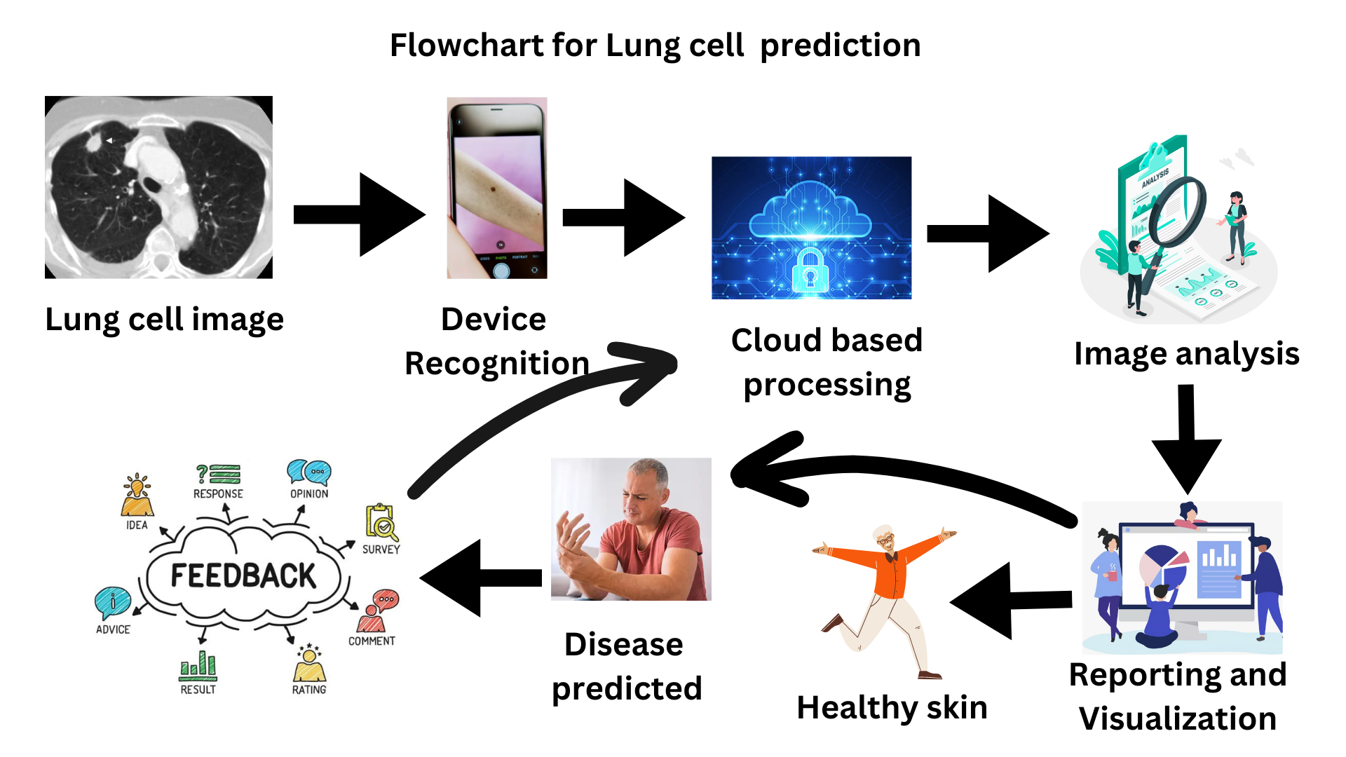
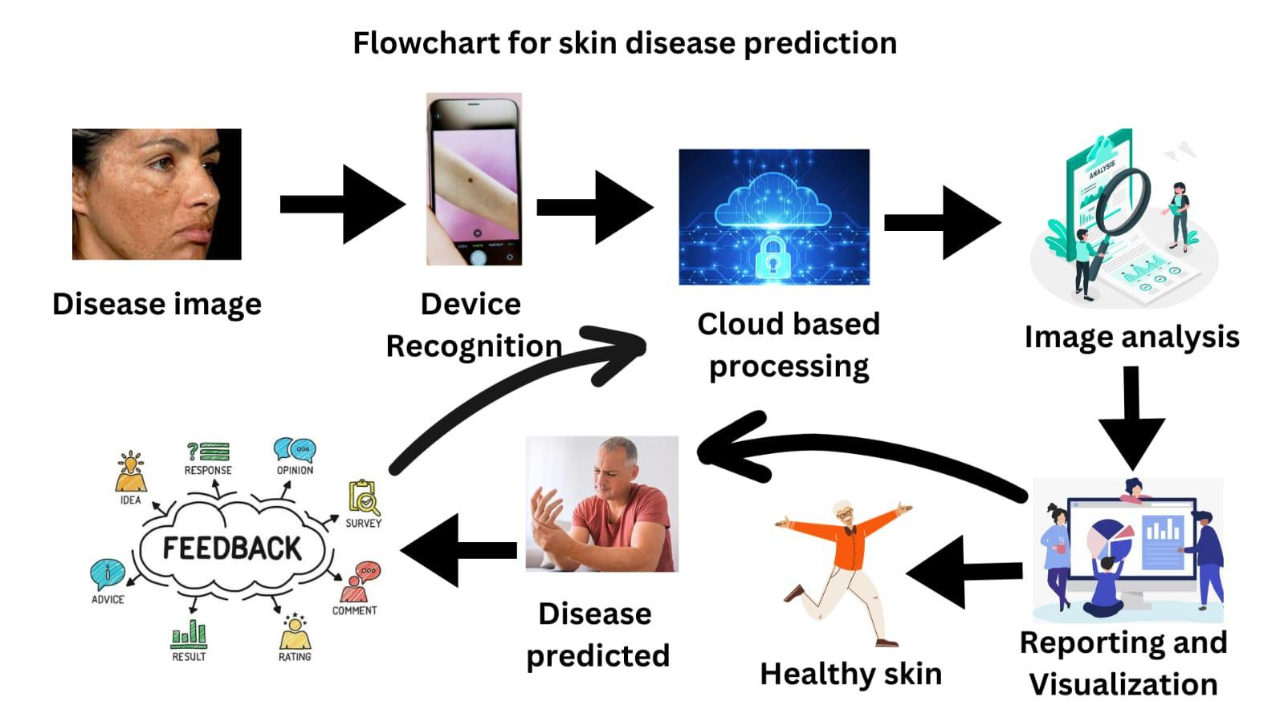
DERM AI

Slide 10

THANK'S FOR WATCHING
LUNG - AI

